Slide 1
Breast Cancer Jump Scare Team 5
Cadeem Musgrove, Lucas Perez, Jaskirat Singh & Aditya Singh
Notes:
Good evening, we our Team 5, that is: Lucas Perez, Cadeem Musgrove, Aditya and Jaskirat Singh. Today we will be presenting our project Breast Cancer Jump Scare.

Slide 2
Project Valuation
UTILITY
Better effective treatment allocation
Drug Development
BUSINESS
Pharmaceutical Companies
MODEL VALUAITON
Accuracy of the model and its predictive capability

Slide 3
Agenda
This study aims to create models and visualizations that showcase a breast cancer patient’s survivability and their recommended treatment for clinicians to use.
About the Data | Data sources, time range, size, and end to end data flow from source to consumption with components and connectors describing how data evolves through the flow to generate end visuals and for modelling​
Exploratory Analysis 1​ | Modelling Experiment, Evaluation
Exploratory Analysis 2 | Modelling Experiment, Evaluation
Exploratory Analysis 3​ | Modelling Experiment, Evaluation
Discussion | Discussing our key learnings, future implementations, and our limitations
Notes:
The agenda for today is to discuss the models and show off the visualizations we created to analyze the survivability and potential treatments for a breast cancer patient. So we will briefly discuss the data, then talk about the models we used before wrapping up with some considerations.

Slide 4
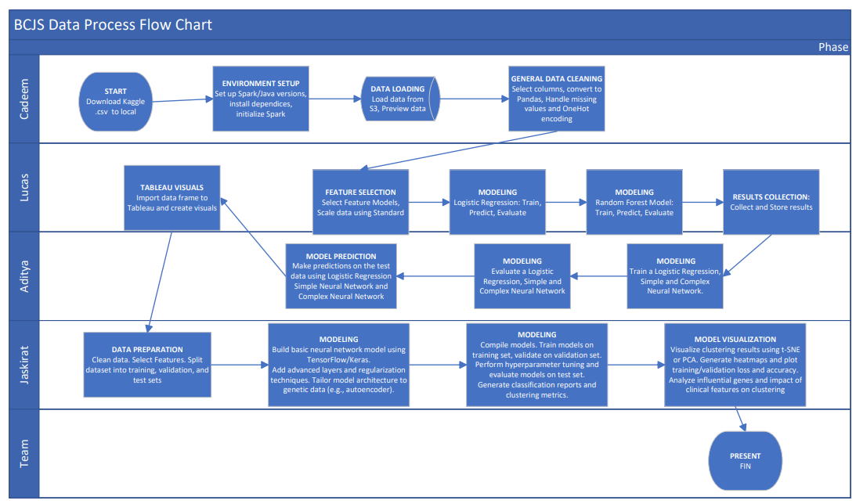
Notes:
I downloaded the data from Kaggle and and had it Stored in an S3 bucket. I loaded the data, cleaned it and provided it to Lucas and Aditiya whom each used it to select their own target and feature variables. They both went on to prepare logestic regressions however to gain more insight, Lucas used his data to prepare a Random Survival Forest Model while Aditiya prepared and fine-tuned Sequential Neural network models. We then used Tableau visualize their interests. On the other hand, Jaskirat took the unclean data and looked at the clinical data and genetics data from the dataset, specifically BRCA1 and BRCA2 gene column and did a clustering on them.

Slide 5
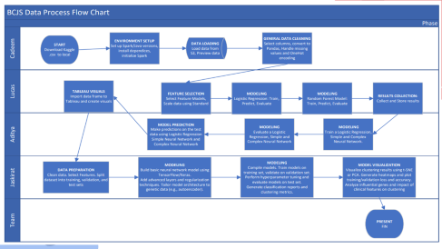

About the Data
Data Description
Sourced from Kaggle. Data is 1904 Rows x 676 Columns. Data is taken between 2016 to 2020
Data Process
Notes:
Our data was taken from Kaggle and it was selected because we were interested in the stories we could create with it. The Data has just over 1900 records, 676 columns and it was recorded between 2016 and 2020. Next we’ll look at the data processing

Slide 6
Exploratory Analysis 1
Key Insights on Target Variables
Target variable ‘overall_survival’ is binary. Indicates whether a patient survived over a period of time.
Modeling Experiment Design
Baseline model: Logistic Regression Model.
Random Survival Forest (RSF) Model employed to handle survivability over time (time-to-event data)
Notes:
Key Insights on Target Variable Distribution:
The target variable, overall_survival, is binary and indicates whether a patient survived beyond a specific period. In this analysis, the distribution of this target variable was examined to understand the balance between the two classes.
Modelling Experiment Design
These experiments were chosen because logistic regression provides a straightforward baseline, while the RSF offers a more specialized approach for survival data, allowing for a nuanced understanding of time-dependent outcomes.

Slide 7
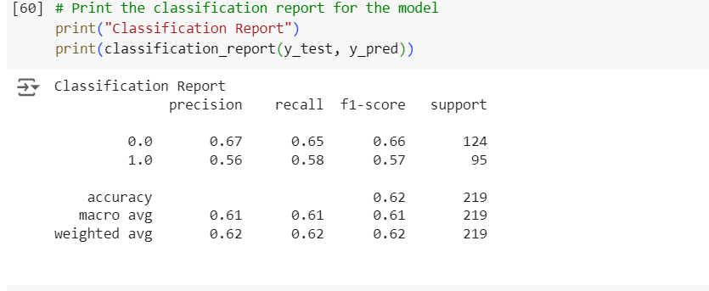
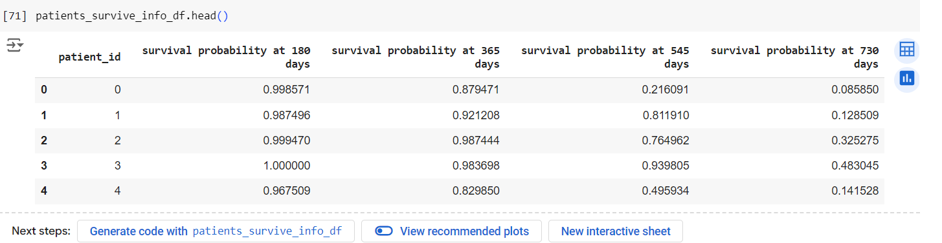
Logistic Regression Model Accuracy
Random Survival Forest Predictions

Slide 8
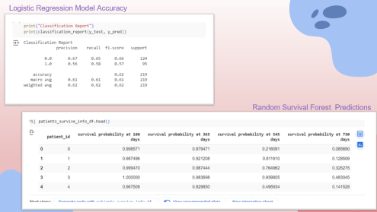
Exploratory Analysis 1
Model Evaluation
Metrics Used
Accuracy: Primary metric in Logistic Regression
Survival Probability Metric: RSF Model different time points (ex. 365 days)
Model Comparison
The RSF model of survival data shows better generalization and performance compared to the baseline logistic regression model.
Snippets of Code
Notes:
Metrics Used:
Accuracy: For logistic regression, accuracy was used as the primary metric. It provides a simple measure of how often the model correctly predicts the survival class.
Survival Probability Metrics: For the RSF model, survival probability at different time points (e.g., 730 days) was evaluated. This approach offers insights into the model's ability to predict long-term outcomes.
Model Comparison:
Performance: The logistic regression model's performance on accuracy was the start. The RSF's performance is likely evaluated based on its survival probability predictions. he RSF might perform better on survival data due to its ability to handle censored data and complex interactions, whereas the logistic regression model, while interpretable, might show limitations in capturing time-dependent survival patterns.
In summary, the RSF model, with its specialized handling of survival data, might show better generalization and performance in this context compared to the baseline logistic regression model.
RSF model was generated to

Slide 9
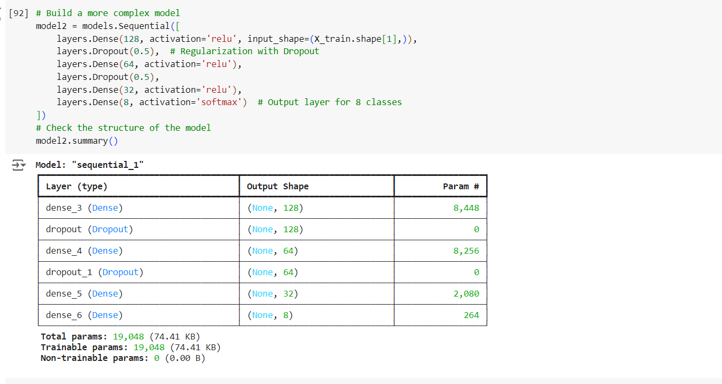
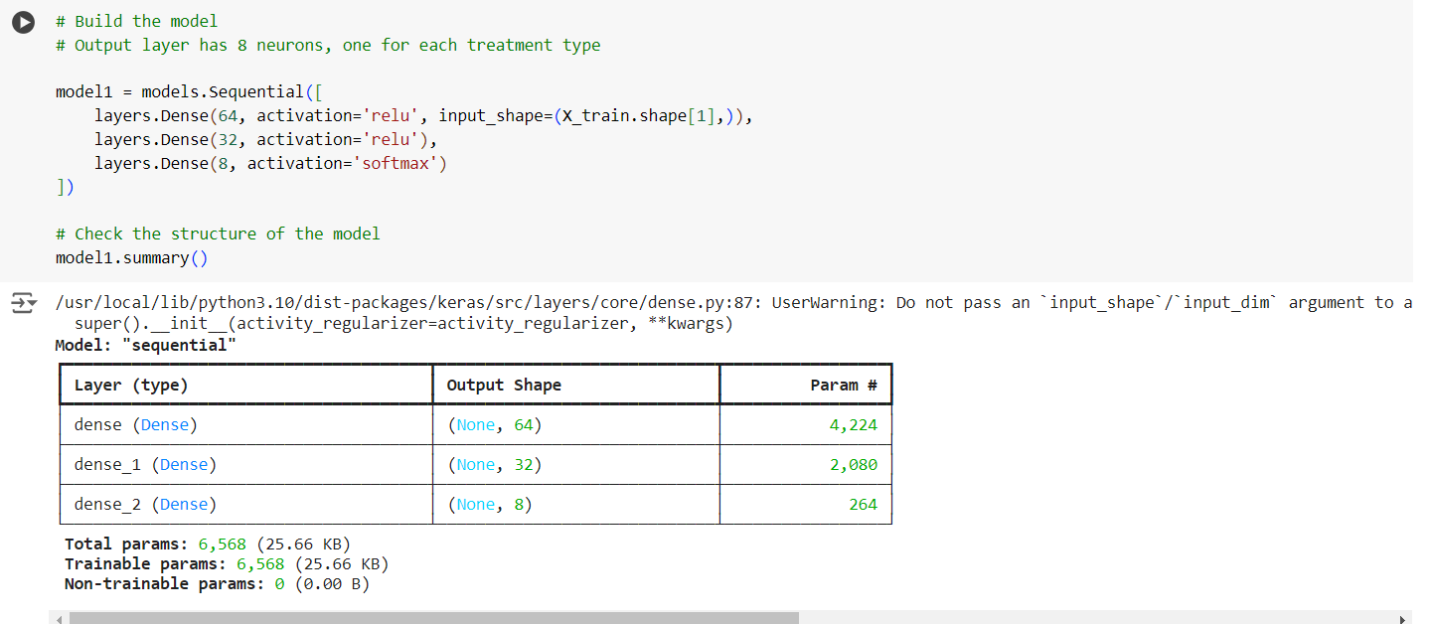
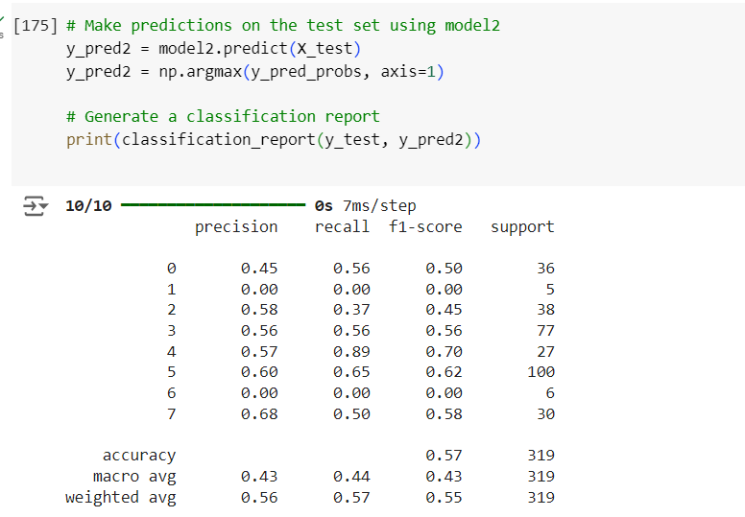
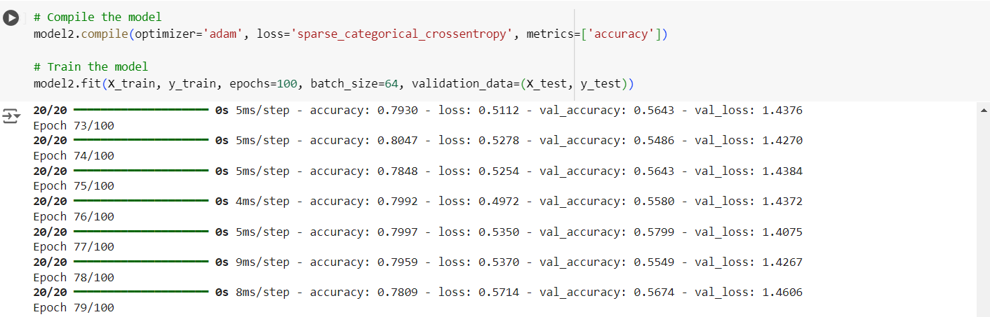
Model 2
Model 1
Training Model with 100 epoch

Slide 10
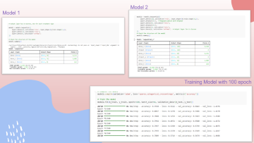
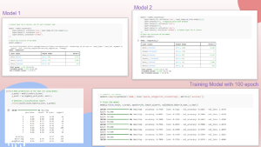
Exploratory Analysis 2
Key Insights
Type of cancer and type of treatment, which treatment is more effective against certain types of cancers.
Model Design
Created Dummys for testing predictions.
Ran Logistics Regression as the measurement is categorical
Model evaluation
Ran with different epochs, neurons, and layers.
To achieve 57% accuracy.
Tableau Visuals
Snippets of Code
Notes:
Here we see a visualization of the difference between survivors and non survivors based on their neoplasm/cancer grade. Blue line are non survivors and pink is surivors. We see at grade 1… next, thanks to lucas survival forest model, we can see predicted times for various patients. We can see patient x The next two visualizations will be looking at the distributions of treatment procedure. In this one, we can see Radiotherapy combined with hormone therapy seems to be the most popular treatment procedure while chemotherapy and hormone therapy only seems to be the least common. Lastly this tree map helps hone in on how those treatment counts associate with survivors and non survivors. With this done, I want to pass the baton to jaskirat to showcase something amazing he got done.

Slide 11
Considerations & Key Lessons
Time
Horizon of the study
Time constrain on the project time line
Scope
11 Models in 2 weeks
Domain Knowledge
Domain expertise in the medical industry

Slide 12

Questions?

